Slide 1
INFORMATION MANAGEMENT
a) Database Management with IM
b) The Database Environment & the ANSI-SPARC Architecture
DEIT 2

Slide 2
Chapter Objectives
Understand the relationship between Information systems, Information Management and database systems.
Some common uses of database systems.
Characteristics of file-based systems.
Problems with file-based approach.
Meaning of the terms database and Database Manage- ment System (DBMS).
Typical functions of a DBMS.
Major components of the DBMS environment.
Personnel involved in the DBMS environment.
History of the development of DBMSs.
Advantages and disadvantages of DBMSs.

Slide 3
Database Systems and Information Management
“The key question for senior managers is: how should we compete with information and IT to improve business performance?“ Donald A Marchand
“In a changing world, for organizations to be effective, …of the new competencies required, none is more crucial than the Management of information.. “ (Powell 1999:46)

Slide 4
Introduction
‘Information management (IM)’ is an umbrella term that encompasses all the systems and processes within an organisation for the creation and use of corporate information.
Information and its management are important for decision making processes of any organisation.
(Feraud, 2000) describes an organisation as an information processor.

Slide 5
The management of information takes place on all levels within an organisation. It can be viewed at the top level (chief executive, MD, board of directors), middle level (branch managers, departmental managers), and lower level (supervisory/operational level consisting of supervisors, foreman, section officers, superintendent etc.)
In order to better serve the various business processes, IM is drawing support from a variety of information systems (IS’s).
IS’s are the tools for IM with the generic purpose to aid decision making and subsequent action.

Slide 6
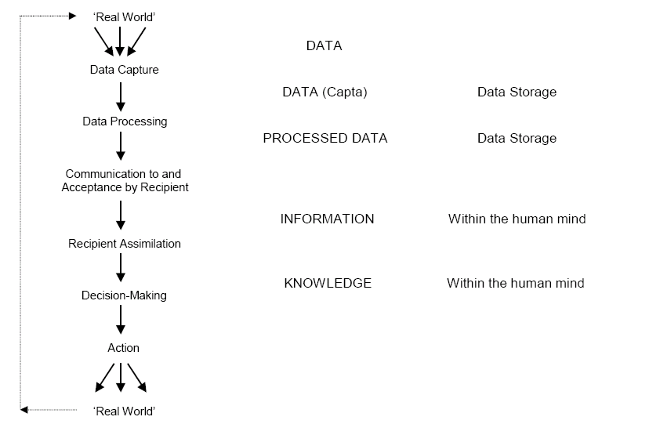
The Information Cycle (Adapted from Heeks 2000a:8)

Slide 7
Information Systems
Since all organizations process information and make decisions, they have information systems of some kind, which must not necessarily be computer based (Heeks 1998).
Information systems consist in principle of at least the following: people, data (information) and some process- ing and storing tools, which can be paper and pencil, calculators, computers or a combination of them.
We need to acknowledge the potential and rapid spread of ICT- based ISs and their inherent potential for problems.
People interact with IS and are affected by them in various ways. Mostly, systems are built with a particular organizational rationality in mind.

Slide 8
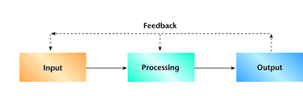
What is an information system?
An information system (IS) is typically considered to be a collection/ a set of interrelated components working together to collect (input), process (manipulate), store, retrieve, & disseminate (output) information for the purpose of facilitating planning, control, coordination, analysis, and decision making in businesses & organisations.

Slide 9
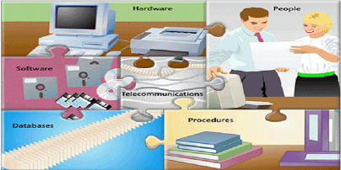
Computer based information system
An Information System is an organized combination of people, hardware, software, communication networks and the data resources that all collect, transform and disseminate information in a organization.

Slide 10
Information Systems
Information systems assist in the processing and storing of data.
(Heeks, 2000) illustrates all the sub-processes of an information system: capture input, processing, storing, retrieving, outputting, followed by the optional decision making and action (Figure 2-3 in the next slide).
It is easy to see on this model, that information (and its management) has a cost.
Everything before (left of) the output incurs a cost and only the improved quality of decisions and actions can generate benefit, although this too is not guaranteed.

Slide 11
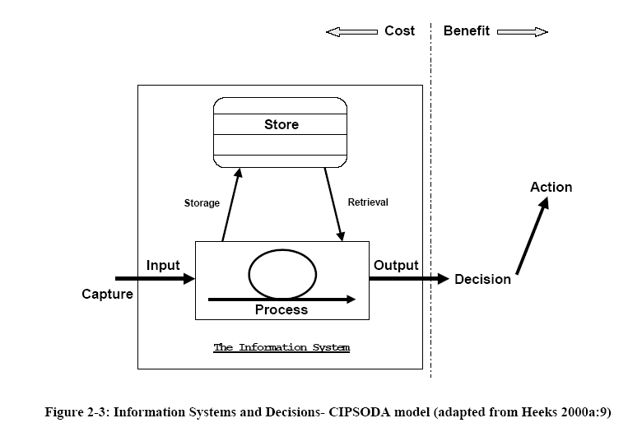
Information systems and Decisions

Slide 12
Information Systems
Input, processing, storage and output are the activities in an IS that manipulate the information an organization needs.
Input – Captures raw data from both the internal & external environments.
Processing – Converts this raw data into a meaningful form
Storage – storing /keeping data permanently on storage devices
Output – transfers the information (processed data) to the people who will use it or to the activities for which it will be used.

Slide 13
Broad categories of Information Systems
These are divided into 3 broad types
Computer based IS
Manual IS
Business IS (Can be defined in a functional and constituency perspective)
i.e:
Functional perspective : Sales and marketing, Manufacturing and production, Finance and accounting & Human resources.
Constituency perspective: Transaction processing systems (TPS), Management information systems (MIS) , Decision support systems (DSS), Executive support systems, Expert systems, KWS
Note: Focus will be put in the first two categories.

Slide 14
Manual system:
Paper based systems don't need electricity to work. They don't get viruses'. It is much more difficult for someone to steal information from a paper based system (provided it is stored safely) than it is for hackers to destroy or break into confidential records in a computer based system.
Computer Based information systems :
A set of hardware, software, database, telecommunica- tions, people, and procedures that are configured to collect, manipulate, store and process data into information.

Slide 15
Hardware: Computer equipment used for performing input, processing and output activities.
Software: The computer programs that govern the operation of the computer.
Database: (Refer to its definition).
Telecommunications: The electronic transmission of signals for communications; which enables organizations to carry out their processes and tasks through effective computer networks.
Networks : Connects computers and equipment in a building, or around the world to enable electronic communications. eg Some Hotels use wireless telecommunication to allow guests to connect to internet

Slide 16
IT Vs IS
Payroll System
INFORMATION TECHNOLOGY
Hardware
Software
Databases
Networks
Other related components
Inventory System
are used to build
INFORMATION SYSTEMS
Marketing System
Customer Service System

Slide 17
DATABASE SYSTEMS

Slide 18
Database Systems – Key Definitions
The database is now the underlying framework of the information system and has fundamentally changed the way many organizations work (Connolly and Carolyn Begg, 2007)
A database is a collection of Logically related data and its the description, designed to meet the information needs of an organization.
A Database Management System (DBMS) is a software that enables users to define, create and maintain, manage and controls access to the database.

Slide 19
Database Systems – Key Definitions
A database application is simply a program that interacts with the database at some point in its (database) execution.
A database system: a system which includes a collection of application programs that interact with the database (a system with a database in the background).

Slide 20
Examples of Database Applications
Purchases from the supermarket
When you purchase goods from a supermarket, it is likely that a database is accessed.
The checkout assistant uses a bar code reader to scan each of your purchases. This is linked to an application program that uses the barcode to find out the price of the item from the products database.
The program then reduces the number of such items in stock and displays the price on the cash register.
If the reorder level falls below a specified threshold, the database system may automatically place an order to obtain more stocks of that item.
If a customer Calls the supermarket, an assistant can check whether an item is in stock. By running an application program that determines availability from the database.

Slide 21
Examples of database application cont’d…
Studying at the university
If you are at university, there is a database system containing information about yourself, the course you are enrolled in, details about your fees payment / your scholarship, the modules you have taken in the previous years or are talking this year and details of all your examination results.
There may also be a database containing details of the staff who work at the university, giving personal details and salary related details for the payroll office.
More example of how and where databases are applied
  Purchases using a credit card
  Booking a holiday at the travel agents
  Using the local library
  Using the Internet

Slide 22
Traditional File Based Systems
The file based system is the predecessor of the database system.
It is largely obsolete…so what are the reasons for studying it:
Understanding the problems inherent in file based systems may prevent us from repeating these problems in database systems. In other words we should learn from our earlier mistakes…. and we have learned over the years, from experience and research that there are better ways to handle data.
If you wish to convert a file-based system to a database system, understanding how the file system works will be extremely useful, if not essential.

Slide 23
Define a file based approach
Collection of application programs that perform services for the end users (e.g. production of reports).
Each program defines and manages its own data.
With a file based approach each user defines and creates with a specific software the files he needs for a specific application. In comparison to the database system approach this results in some limitations that we shall discuss.

Slide 24
File based approach- Examples
Using a file based system it is possible that, for example, the administration of a school maintains information about the registration and fee payment of the students(e.g. based on a spreadsheet software). Meanwhile the lecturers manage data about the students and their grades.
Even though both user groups are interested in student data they both might have different files and different software to update and change these. Such redundancy in the definition and storage of data wastes storage space. Additionally, the work needed to update data in more than one system is multiplied by the number of systems; a change of basic student data like the address might need an update in the system of the lecturer and in the system of the administration as well.

Slide 25
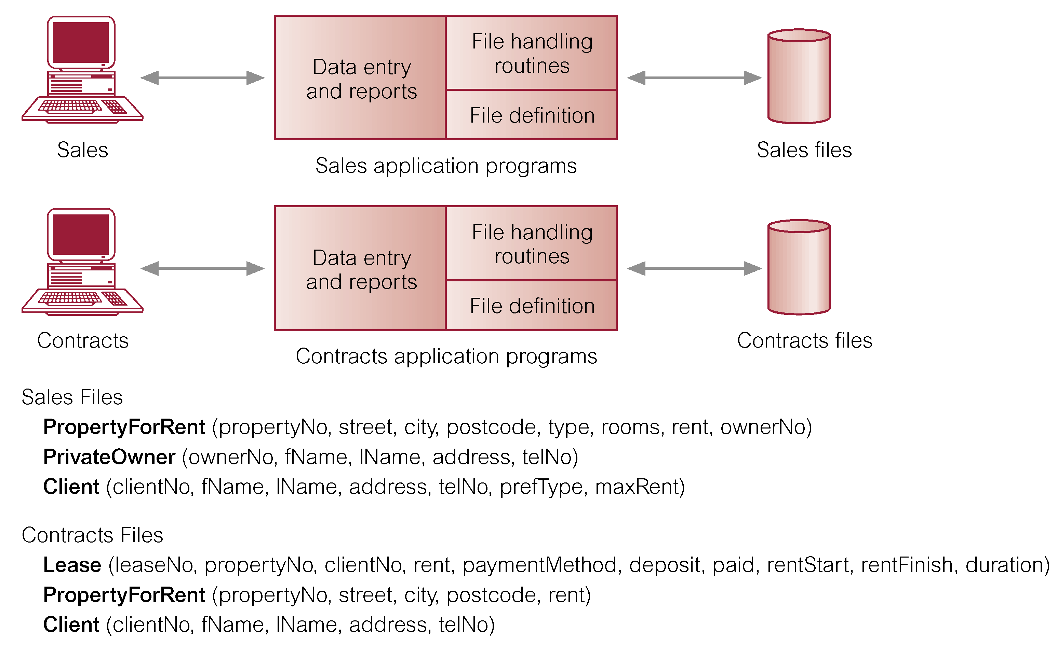
File-based processing

Slide 26
Limitations of file-based approach
Separation and isolation of data
  Each program maintains its own set of data.
  Users of one program may be unaware of potentially useful data held by other programs.
  When data is isolated in separate files, it is more difficult for us to access data that should be available.
  For example from two files looking for Students that achieved good academic results and looking through a different file to see whether these students are on scholarship or not- both files may be stored in different departments that are in charge of such records.

Slide 27
Duplication of data
  Same data is held by different programs.
  Wasted space and potentially different values and/or different formats for the same item are stored in different files.
  -Cost time and money to enter data more than once
  -When additional storage space is needed this directly increases on storage cost
  -Duplication can lead to loss of data integrity – Inconsi-stencies in data

Slide 28
Limitations of file-based approach
Data dependence
  File structure is defined in the program code.
  Using file-based system, the physical structure and storage of the data files and records are defined in the application program code.
  This characteristic is known as program-data dependence. Making changes to an existing structure are rather difficult and will lead to a modification of program. Such maintenance activities are time-consuming and subject to error.

Slide 29
Limitations of file-based approach
Incompatible file formats
  Programs are written in different languages, and so cannot easily access each others files.
Fixed Queries/Proliferation of application programs
  Programs are written to satisfy particular functions. Any new requirement needs a new program.

Slide 30
Database Approach
In order to overcome the limitations of the file-based approach, the concept of database and the Database Management System (DMS) emerged.
The Database Approach mainly arose because:
  Definition of data was embedded in application programs, rather than being stored separately and independently.
  No control over access and manipulation of data beyond that imposed by application programs.
Resulting into:
  the database and Database Management System (DBMS).

Slide 31
Database
Shared collection of logically related data (and a description of this data), designed to meet the information needs of an organization.
System catalog (metadata) provides description of data to enable program–data independence.
Logically related data comprises entities, attributes, and relationships of an organization's information.

Slide 32
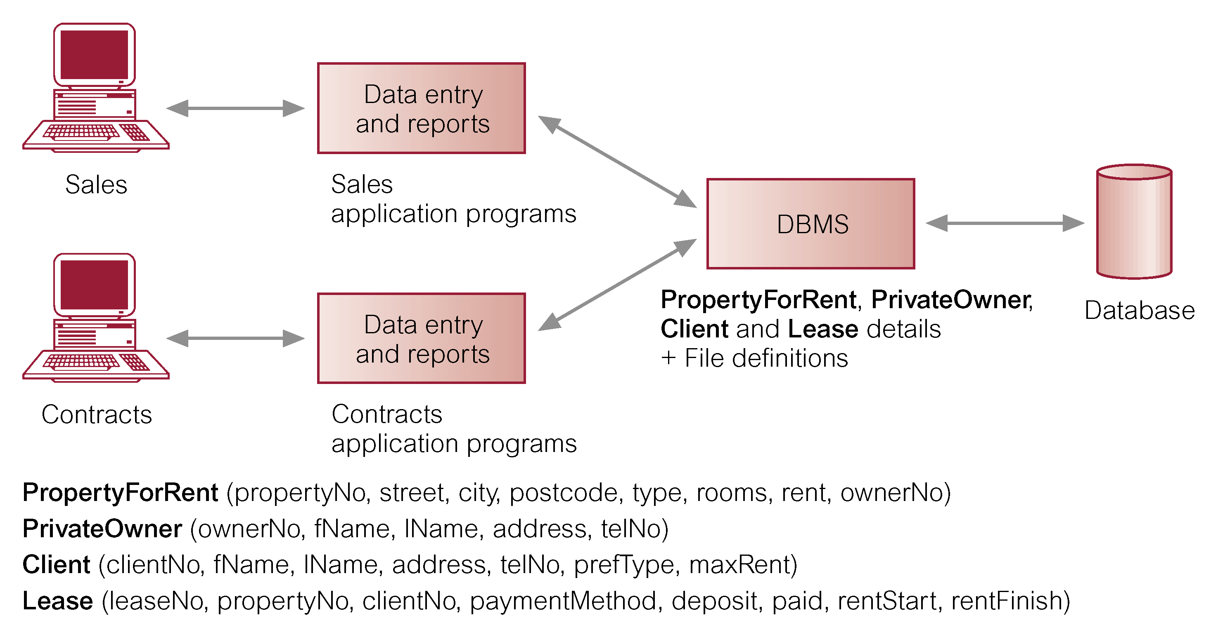
Database Management System
(DBMS)
A software system that enables users to define, create, and maintain the database and provides controlled access to this database.

Slide 33
Database Approach
Controlled access to database may include:
  A security system.
  An integrity system.
  A concurrency control system.
  A recovery control system.
  A user-accessible catalog.
A view mechanism.
  Provides users with only the data they want or need to use - Allows each user to have his or her own view of the database.
  A view is essentially some subset of the database.

Slide 34
Benefits of Views include:
Reduce complexity (by letting users see the data in the way they want to see it)
Provide a level of security; (Views can be set up to exclude data that some users should not see. For example, we could create a view that allows a branch manager and the Payroll Department to see all staff data, including salary details. However, we could create a second view that excludes salary details, which other staff use.)
Views provide a mechanism to customize the appearance of the database.
Views present a consistent, unchanging picture of the structure of the database, even if the underlying data-base is changed.

Slide 35
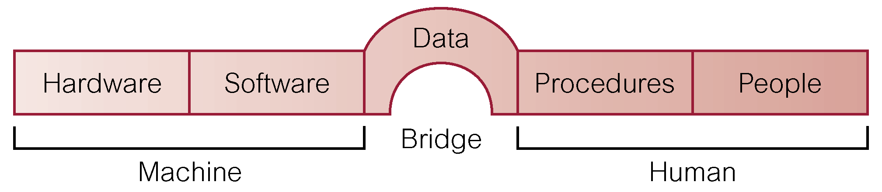
Components of DBMS Environment

Slide 36
Components of DBMS Environment
Hardware
  Can range from a PC to a network of computers.
Software
  DBMS, operating system, network software (if necessary) and also the application programs.
Data
  Used by the organization and a description of this data called the schema.
Procedures
  Instructions and rules that should be applied to the design and use of the database and DBMS.
People
  Create and work with/use the database

Slide 37
Roles in the Database Environment
Data Administrator (DA) Same as "database analyst”
Database planning
System definition
Requirements collection and analysis
Data conversion and loading
Operational maintenance
Database Administrator (DBA)
Helps realise the Database
Physical database design
DBMS selection
Implementation
Testing
Prototyping
Maintenance and Repair

Slide 38
Roles in the Database Environment Cont’d
Database Designers (Logical and Physical Designers) Designs include ER diagrams, data dictionary, database schema…to be looked at when studying Database Management Systems
Application Programmers
End Users (we have the naive and the sophisticated database users)

Slide 39
History of Database Systems
First-generation: Hierarchical and Network (Mainly used on mainframe computers)
Hierarchical: A record search is conducted by starting at the top of the tree and working down through the tree from parent to child until the appropriate child record is found. Furthermore, each child can also be a parent with children underneath it.
Network is like hierarchical though it works like a cobweb where in network databases, children are called members and parents are called owners. The most important difference is that each child or member can have more than one parent (or owner).

Slide 40
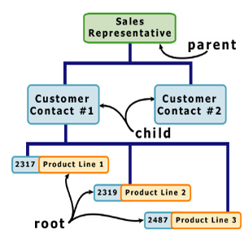
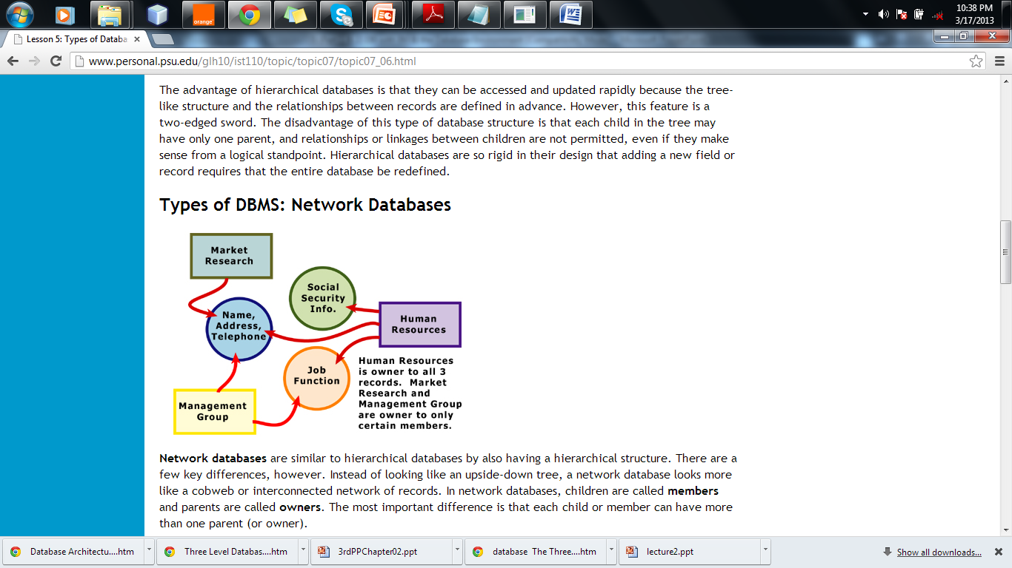
Hierarchical
Network

Slide 41
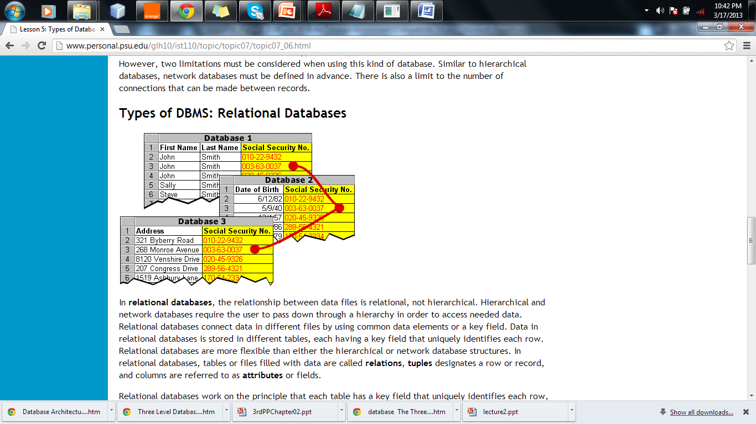
Second generation
Relational:- data and relations between them are organized in tables.
Properties of relational tables: values are atomic, each row is unique, column values are of the same kind, the sequence of columns is insignificant, the sequence of rows is insignificant each column, has a unique name.

Slide 42
Third generation
  Object Relational & Object-Oriented
Able to handle many new data types, including graphics, photographs, audio, and video. Hierarchical and network databases are all designed to handle structured data; that is, data that fits nicely into fields, rows, and columns. They are useful for handling small snippets of information such as names, addresses, zip codes, product numbers, and any kind of statistic or number you can think of.
On the other hand, an object-oriented database can be used to store data from a variety of media sources, such as photographs and text, and produce work, as output, in a multimedia format.

Slide 43
Third generation
Object Relational & Object-Oriented
Object-oriented databases use objects that are stored in the object-oriented database. Each object consists of two elements: 1) a piece of data (e.g., sound, video, text, or graphics), and 2) the instructions, or software programs called methods, for what to do with the data.
The instructions contained within the object are used to do something with the data in the object. For example, test scores would be within the object as would the instructions for calculating average test score.

Slide 44
Advantages and Disadvantages of each
Advantages | Disadvantages
Hierarchical
They can be accessed and updated rapidly because the tree-like structure | Each child in the tree may have only one parent, and relationships or linkages between children are not permitted, even if they make sense from a logical standpoint. Hierarchical databases are so rigid in their design that adding a new field or record requires that the entire database be redefined.
Network
Since more connections can be made between different types of data, network databases are considered more flexible | There is a limit to the number of connections that can be made between records.

Slide 45
Advantages | Disadvantages
Relational
The relational database has become quite popular for two major reasons. First, relational databases can be used with little or no training. Second, database entries can be modified without redefining the entire structure. | The downside of using a relational database is that searching for data can take more time than if other methods are used.
Object Oriented
The ability to mix and match reusable objects provides incredible multimedia capability. Healthcare organizations, for example, can store, track, and recall CAT scans, X-rays, electrocardiograms and many other forms of crucial data. | First, they are more costly to develop. Second, most organizations are reluctant to abandon or convert from those databases that they have already invested money in developing and implementing.

Slide 46
Database Systems
  Relational Database Systems are the most common type of database systems today:- data and relations between them are organized in tables.
  Properties of relational tables: values are atomic (Atomic values in a relational database mean that they cannot be further divided), each row is unique, column values are of the same kind the sequence/series of rows and columns is insignificant and each column has a unique name.

Slide 47
Advantages of DBMS
Control of data redundancy
Data consistency as redundancies are reduced
More information from the same amount of data.
Sharing of data - Data in a database can be shared by all authorised users
Improved data integrity - Database integrity provides the validity and consistency of stored data. Integrity is usually expressed in terms of constraints, which are consistency rules that the database is not permitted to violate.

Slide 48
Advantages of DBMS
Improved security- provides protection of data from unauthorised users. User names and pass- words required to identify the user and their access rights in operations like retrieval, insertion, updating and deleting database records
Enforcement of standards including data formats, naming conventions, documentation standards, update procedures and access rules
Economy of scale-Cost savings can be obtained by combining all organization's operational data into one database with applications to work on one source of data

Slide 49
Advantages of DBMS
Balanced conflicting requirements-By having a structural design in the database, the conflicts between users or departments can be resolved. Decisions will be based on the data in the organizational database as a whole rather that for an individual entity
Improved data accessibility and responsiveness- By having an integration in the database approach, data accessing can be across departmental boundaries
Increased productivity-The database approach provides all the low-level file-handling routines. The provision of these functions allows the programmer to concentrate more on the specific functionality required by the users

Slide 50
Advantages of DBMS
Improved maintenance through data independence
Increased concurrency-can manage concurrent data access effectively. It ensures no interference between users that would not result into any loss of information nor loss of integrity
Improved backup and recovery services- Modern database management system provides facilities to minimize the amount of processing that can be lost following a failure by using the transaction approach

Slide 51
Disadvantages of DBMS
Complexity-Database management system is an extremely complex piece of software. All parties must be familiar with its functionality and take full advantage of it. Therefore, training for the administrators, designers and users is required.
Size-The database management system consumes a substantial amount of main memory as well as a large number amount of disk space in order to make it run efficiently.
Cost of DBMS-A multi-user database management system may be very expensive. Even after the installation, there is a high recurrent annual maintenance cost on the software.

Slide 52
Disadvantages of DBMS
Additional hardware costs
Cost of conversion-When moving from a file-base system to a database system, the company is required to have additional expenses on hardware acquisition and training cost
Performance-As the database approach is to cater for many applications rather than exclusively for a particular one, some applications may not run as fast as before.
Higher impact of a failure-The database approach increases the vulnerability of the system due to the centralization. As all users and applications reply on the database availability, the failure of any component can bring operations to a halt and affect the services to the customer seriously.

Slide 53
5b)
Database Environment
and
The ANSI-SPARC Architecture
(American National Standards Institute, Standards Planning And Requirements Committee)

Slide 54
Objectives
In this section, we shall look at:
The purpose of the three-level database architecture.
Contents of external, conceptual, and internal levels.
Purpose of external/conceptual and conceptual / Internal mappings.
Meaning of logical and physical data independence
Distinction between DDL and DML.
A classification of data models.

Slide 55
Objectives cont’d
Purpose/importance of conceptual modelling.
Typical functions and services a DBMS.
Meaning of client–server architecture and advantages of this type of architecture for a DBMS.
Function and importance of a system catalog.

Slide 56
THE THREE LEVEL - ANSI-SPARC ARCHITECTURE
Objectives of the Three-Level Architecture
All users should be able to access the same data
A user's view is immune to changes made in other views.
Users do not need to know physical database storage details.
  It hides the physical storage details from users - they should be allowed to work with the data itself, without concern for how it is physically stored.

Slide 57
Objectives of Three-Level Architecture cont’d
DBA should be able to change database storage structures without affecting the users' views.
Internal structure of database should be unaffected by changes to physical aspects of storage. For example, a changeover to a new disk.
DBA should be able to change conceptual structure of database without affecting all users.

Slide 58
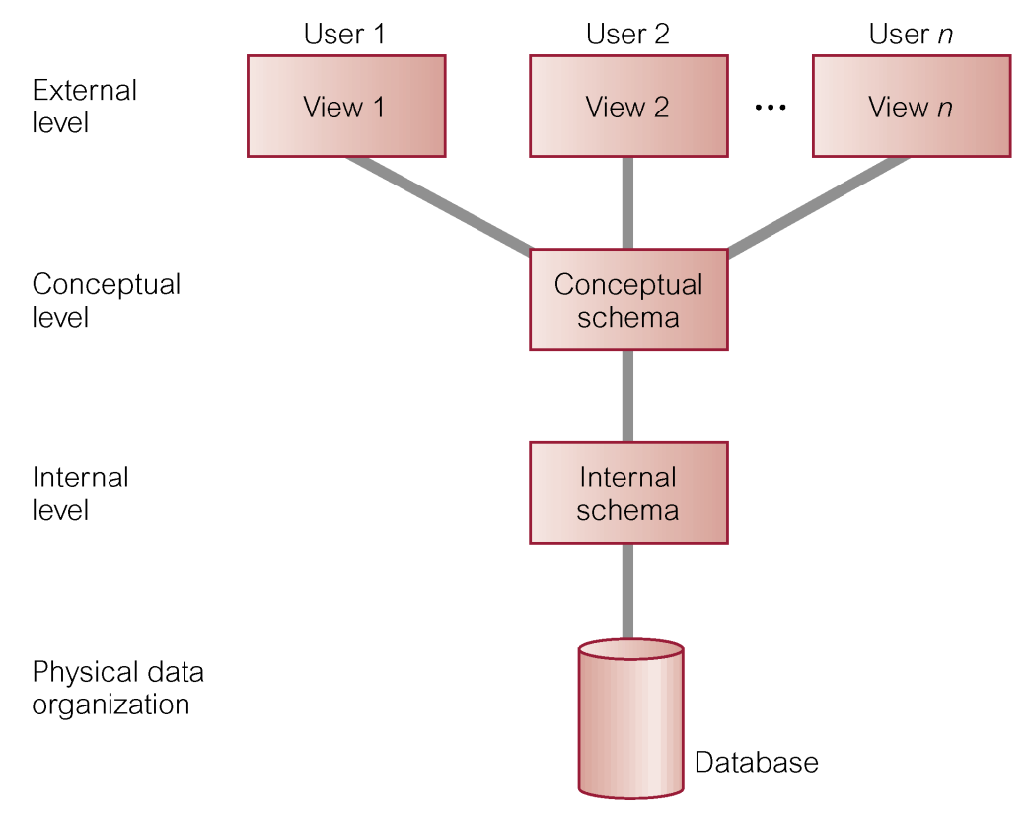
ANSI-SPARC Three-level Architecture

Slide 59
Views
A view mechanism provides users with only the data they want or need to use.
Allows each user to have his or her own view of the database.
A view is essentially some subset of the database.

Slide 60
Views
Benefits include:
  Reduce complexity;
  Provide a level of security;
  Provide a mechanism to customize the appearance of the database;
  Present a consistent, unchanging picture of the structure of the database, even if the underlying database is changed.
*Refer to explanations of benefits already given in the previous slides

Slide 61
ANSI-SPARC Three-level Architecture
External Level
  Users' view of the database.
  Describes that part of database that is relevant to a particular user.
Conceptual Level
  Content view of the database.
  Describes what data is stored in database and relationships among the data.
Internal Level
  Physical representation of the database on the computer.
  Describes how the data is stored in the database.

Slide 62
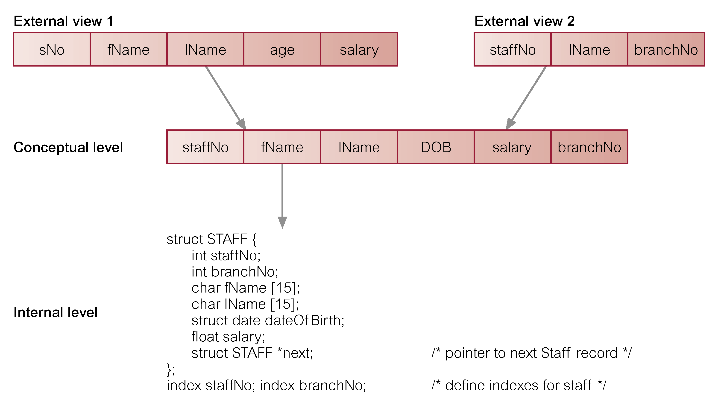
Differences between the Three Levels of ANSI-SPARC Architecture

Slide 63
DATA INDEPENDANCE
The ability of upper levels of the ANSI-SPARC ARCHITECTURE to be immune to changes in the lower levels.
Logical Data Independence
  Refers to immunity of external schemas to changes in conceptual schema.
Physical Data Independence
  Refers to immunity of conceptual schema to changes in the internal schema.
  Internal schema changes (e.g. using different file organizations, storage structures/devices) Should not require change to conceptual or external schemas.

Slide 64
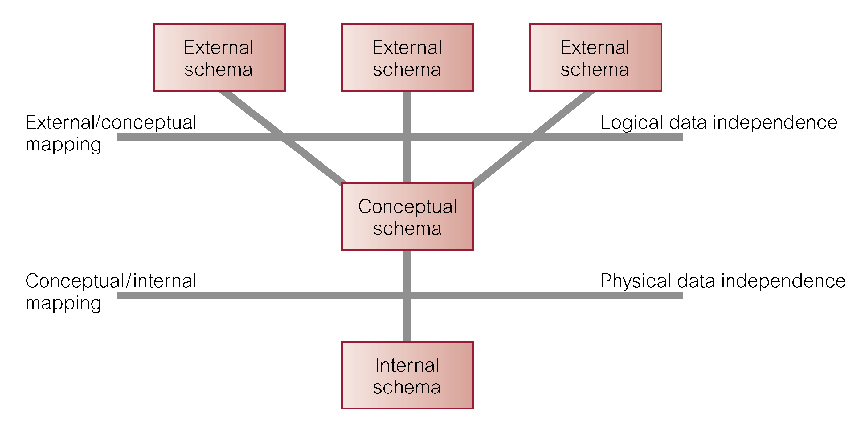
Data Independence and the ANSI-SPARC Three-level Architecture

Slide 65
Database Languages
Data Definition Language (DDL)
  Allows the DBA or user to describe and name entities, attributes, and relationships required for the application
  Plus any associated integrity and security constraints.
  Permits specification of data-types, structures and constraints.
  All specifications are stored in the database.

Slide 66
Database Languages
Data Manipulation Language (DML)
  Provides basic data manipulation operations on data held in the database.
Procedural DML
  Allows user to tell system exactly how to manipulate data. General enquiry facility (query language) of the data
Non-Procedural DML
  Allows user to state what data is needed rather than how it is to be retrieved.

Slide 67
Database Languages cont’d
Fourth Generation Language (4GL)
  Query Languages
  Forms Generators
  Report Generators
  Graphics Generators
  Application Generators

Slide 68
Data Model
An integrated collection of concepts for describing data, relationships between data, and constraints on the data in an organization.
Data Model comprises:
  A structural part
  A manipulative part
  Possibly a set of integrity rules
Purpose
  To represent data in an understandable way.
**Data Models to be explored when studying Database Management Systems.

Slide 69
Data Model cont’d
Purpose
  To represent data in an understandable way.
Categories of data models include:
  Object-based
  Record-based
  Physical

Slide 70
Data Models
Object-based Data Models
  Entity-Relationship
  Semantic
  Functional
  Object-Oriented
Record-based Data Models
  Relational Data Model
  Network Data Model
  Hierarchical Data Model
Physical Data Models

Slide 71
Conceptual modelling
Is the process of constructing a model of information use that is independent of implementation details.
Conceptual schema supports all user views.
Should be a complete and accurate representation of an organization's data requirements.
Result: Conceptual data model.

Slide 72
Functions of a DBMS
Data Storage, Retrieval, and Update.
A User-Accessible Catalog.
Transaction Support.
Concurrency Control Services.
Recovery Services.
Authorization Services.
Support for Data Communication.
Integrity Services.
Services to Promote Data Independence.
Utility Services.

Slide 73
Client-server
Server holds the database and the DBMS.
Client manages user interface and runs applications.
Advantages include:
  Wider access to existing databases
  Increased performance
  Possible reduction in hardware costs
  Reduction in communication costs
  Increased consistency.

Slide 74
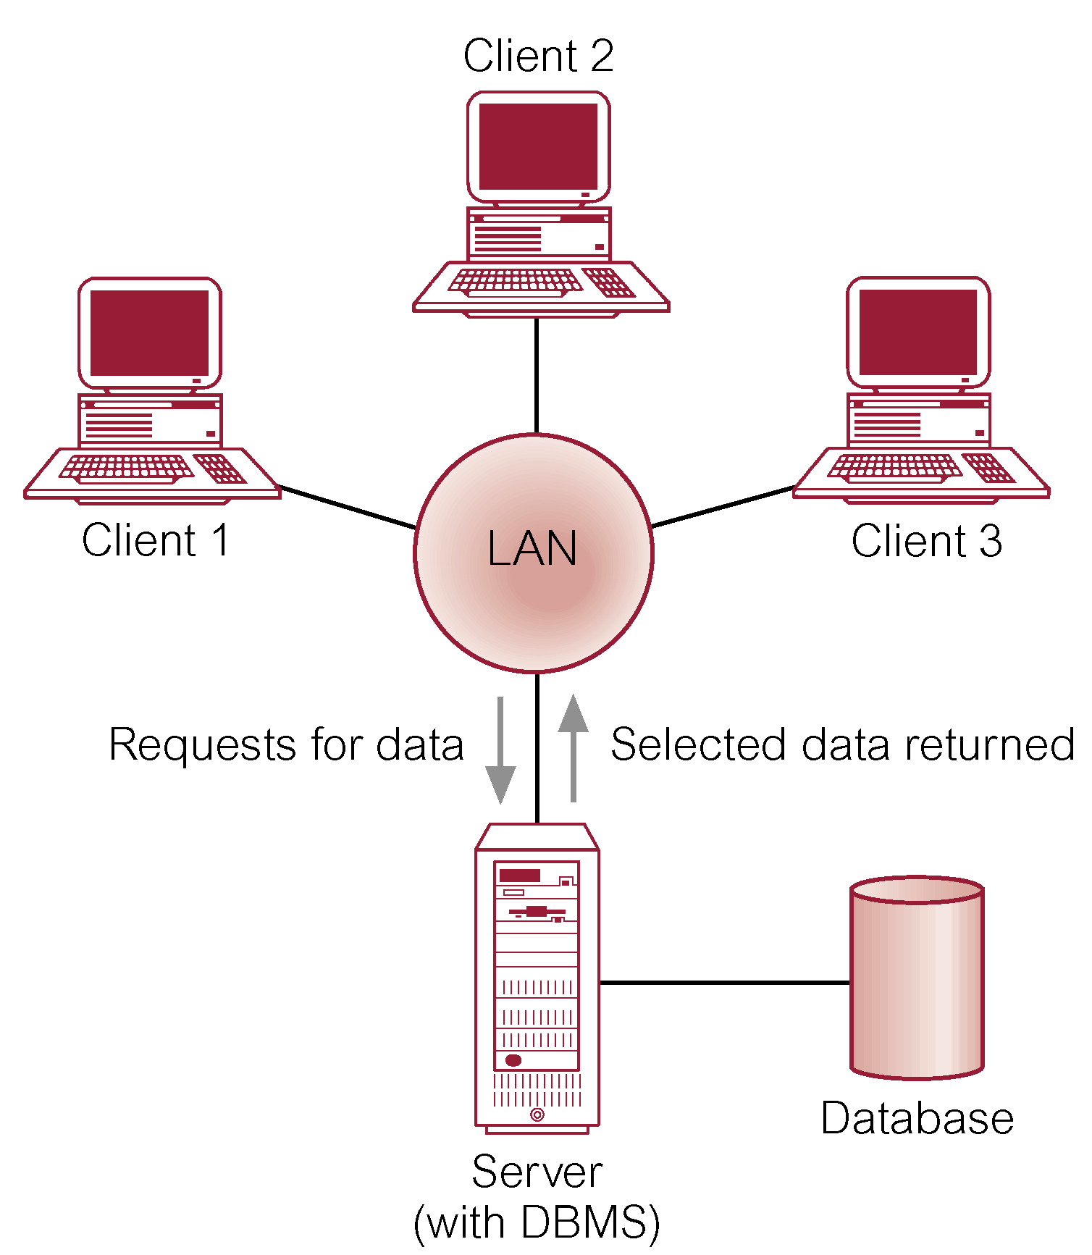
Client-server Architecture

Slide 75
System Catalog
Repository of information (metadata) describing the data in the database.
Typically stores:
  Names of authorized users.
  Names of data items in the database.
  Constraints on each data item.
  Data items accessible by a user and the type of access.
Used by modules such as Authorization Control and Integrity Checker.

Slide 76

Thank You

